Slide 1
Lecture 15 16 Wireless Network

Slide 2
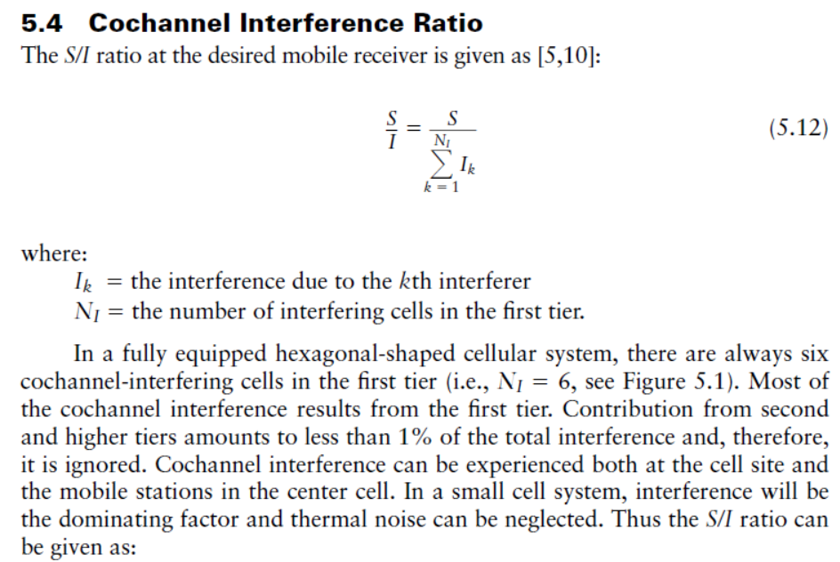
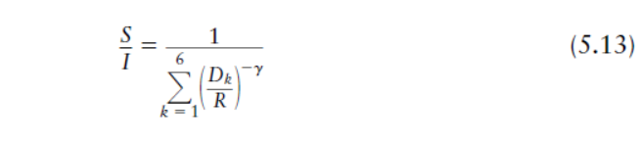

Slide 3
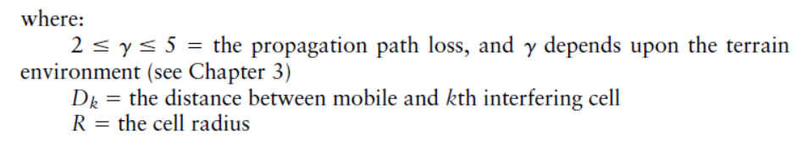
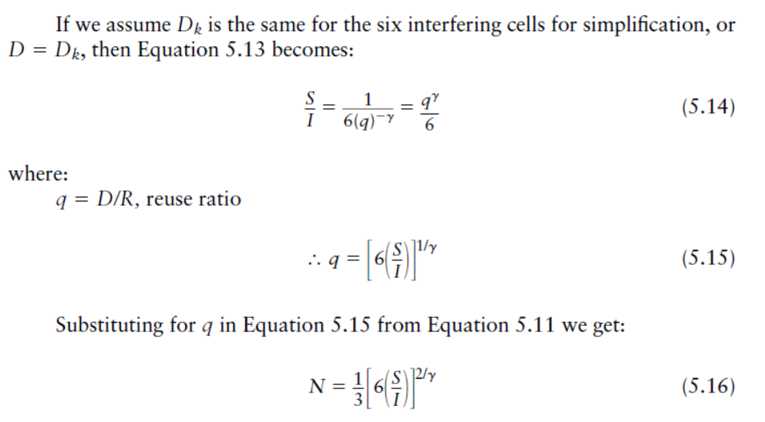

Slide 4
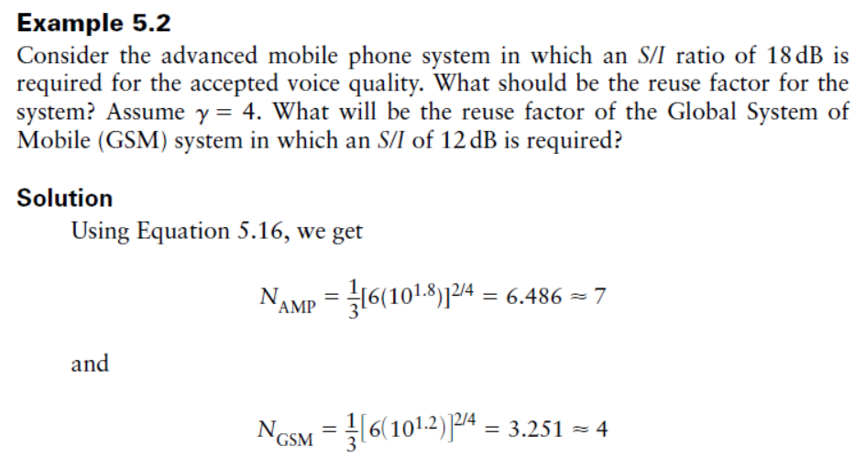
(Vijay Garg)

Slide 5
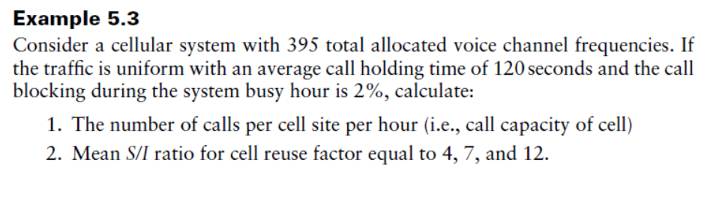
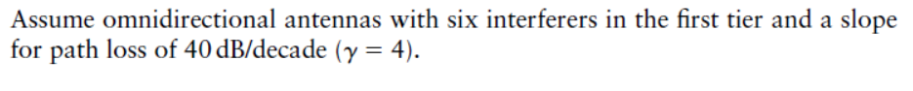
(Vijay Garg)

Slide 6
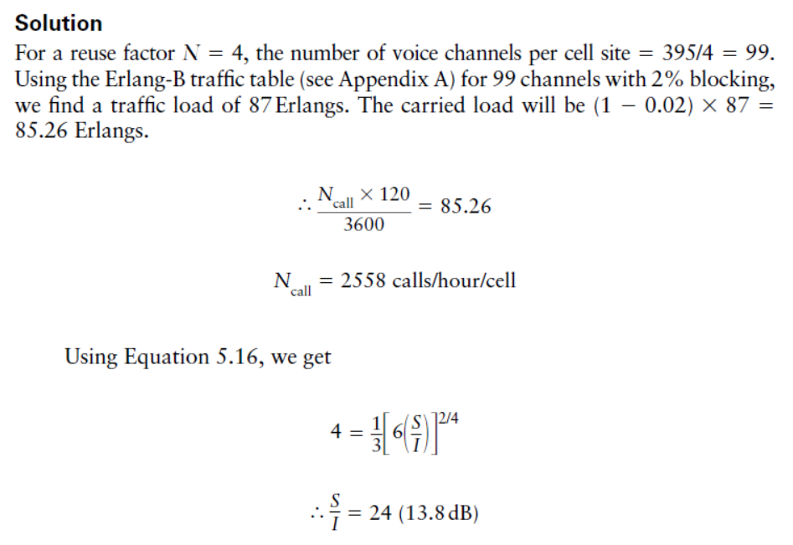

Slide 7
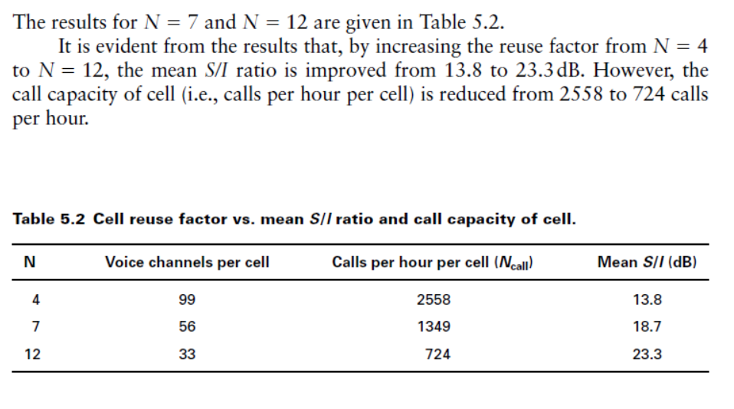

Slide 8
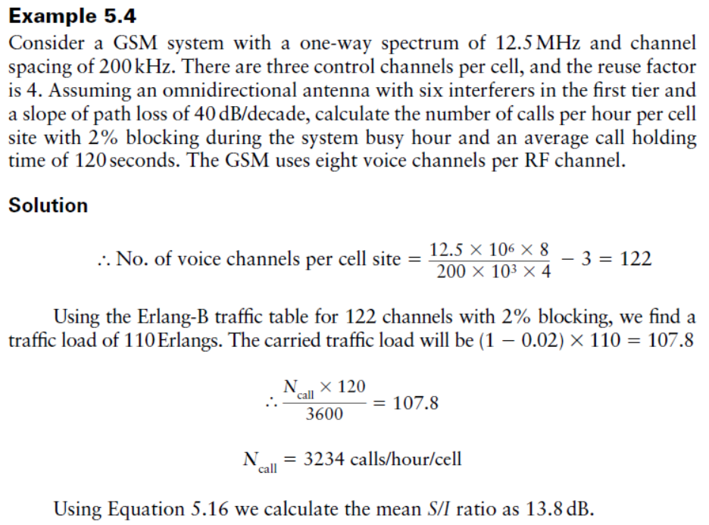
(Vijay Garg)

Slide 9
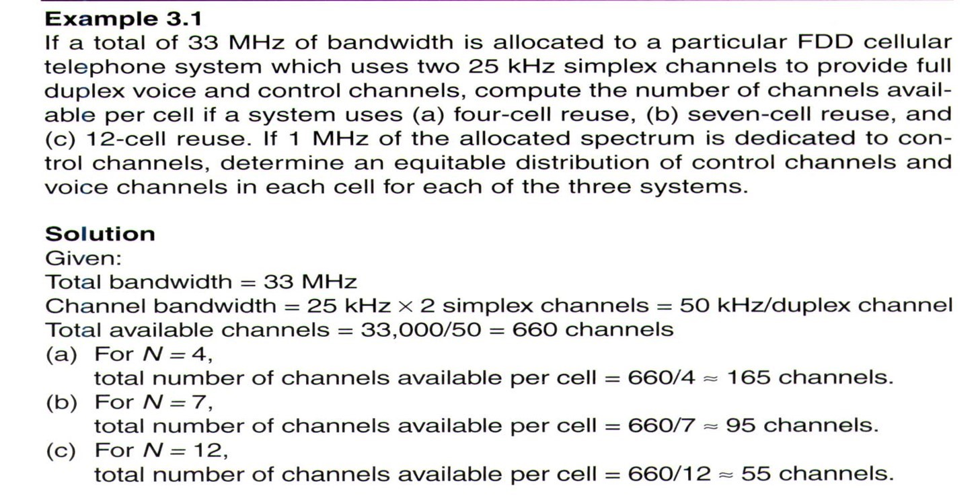
2.1 (Rappaport)

Slide 10
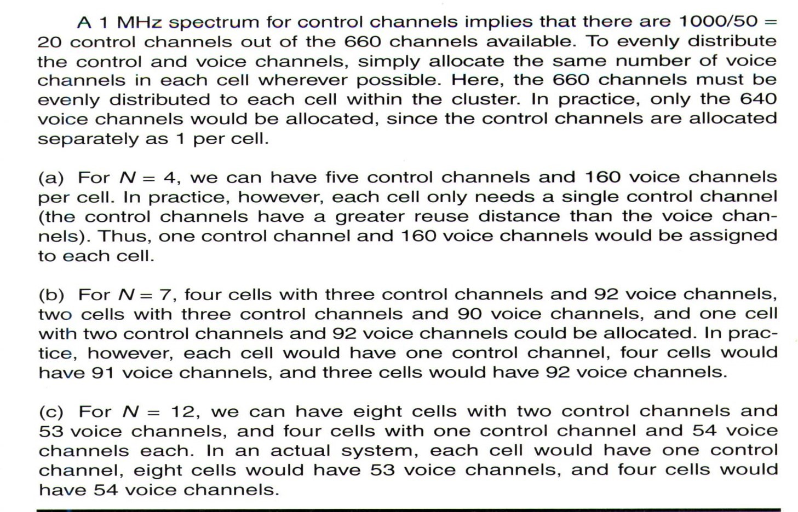
2.1 (Rappaport)

Slide 11
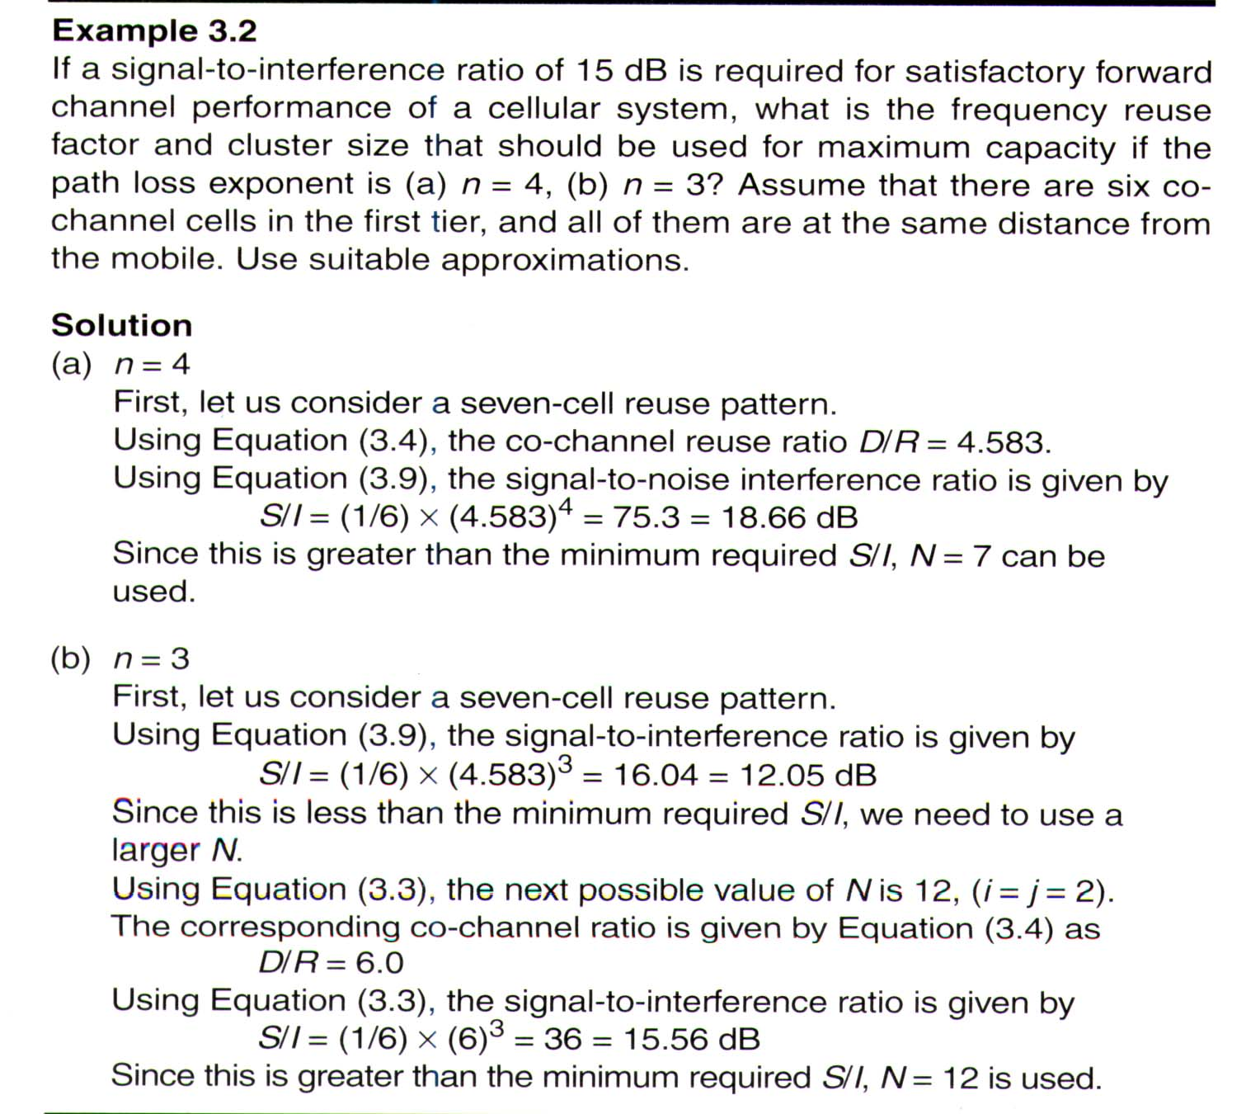
2.2 (Rappaport)

Slide 12
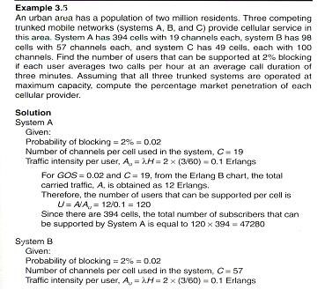
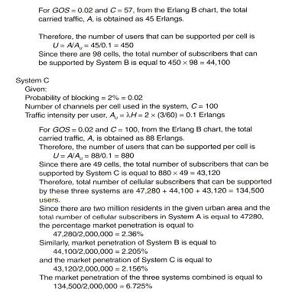
2.5 (Rappaport)

Slide 13
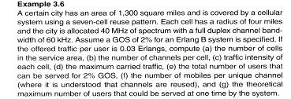
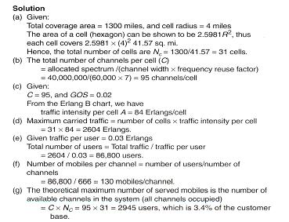
2.6 (Rappaport)
Notes:
3.Root of 3/2

Slide 14
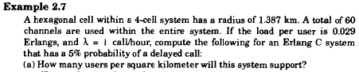
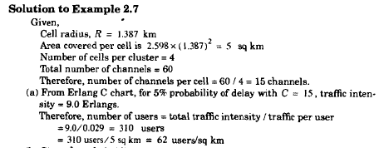
Notes:
(3 X Root 3)%2

Slide 15
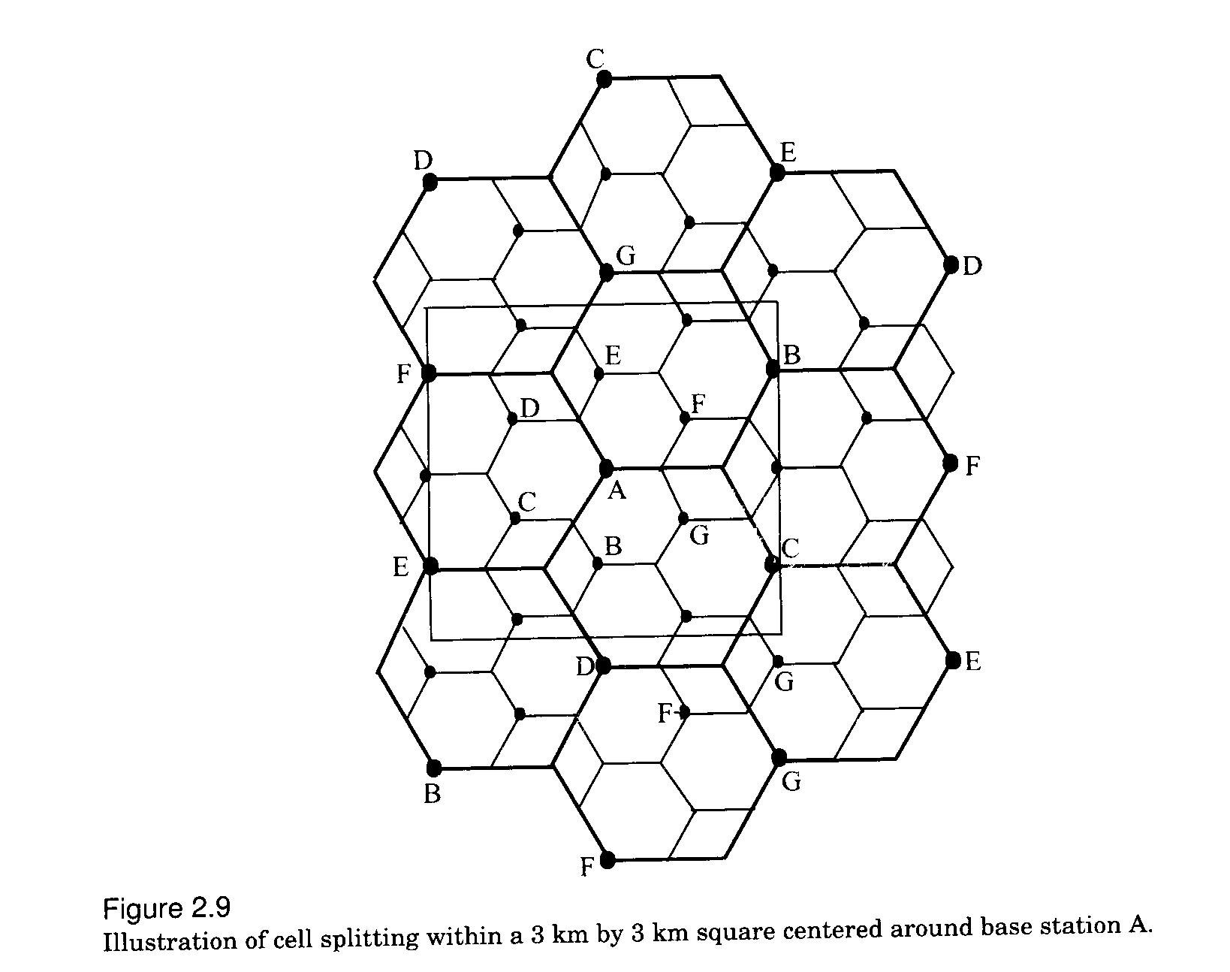
Fig 3.9

Slide 16
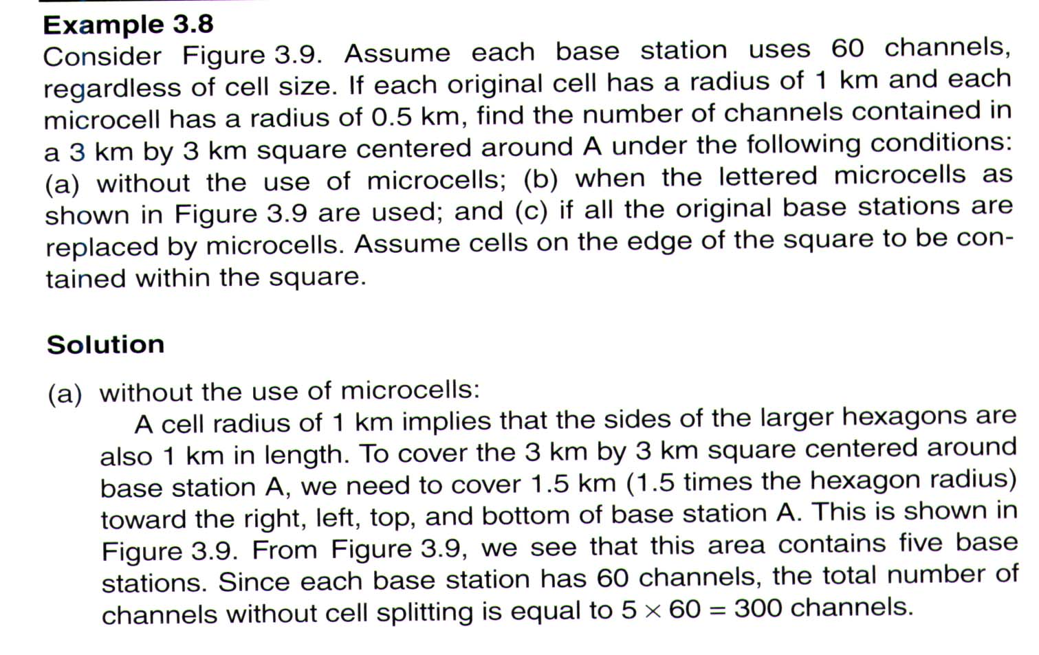
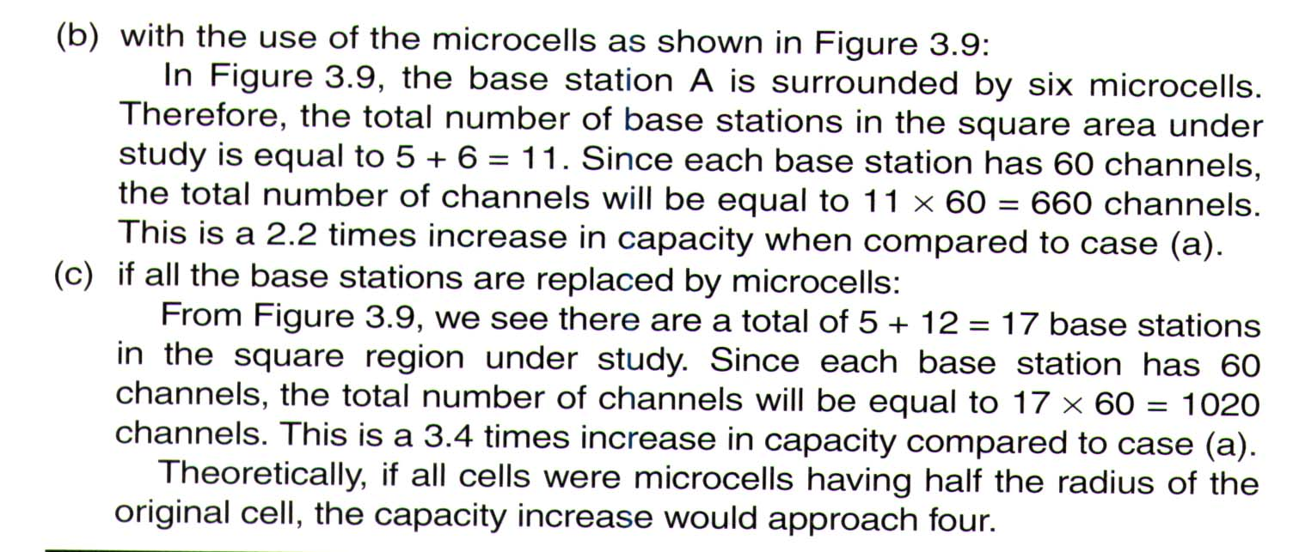

Slide 17
wireless communication
Goldsmith
Example-1
A city has total population of 5,00,000. A network planar found the behavior of users of the city like: they generate 2 calls/hour with average holding time of 1.5 minutes. The service provider got the license of BW that can support 27 carriers of GSM. Determine number of sectors of 3/9 cell pattern maintaining GoS of 5%.
Ans.
Traffic intensity/user = 2(1/60)1.5 = 0.05Erl
Carrier/sector = 27/9 = 3 carriers
Traffic channels/sector = 3*8-3 = 21
Where one TS out of 8TS is considered as control chanel.
From Erlang’s table,
For n = 21 and B = 5%, offered traffic A=16.189Erl
Number of users/sector = 16.189/0.05 = 324
Number of sectors = 5,00,000/324 =1544
Number of 3-sectored cell = 1544/3 = 515
Number of cell pattern = 515/3 = 172 or 1544/9=172
Sector-1
Sector-2
Sector-3
Sector-2
Sector-1
Sector-2
Sector-1
Sector-3
Sector-3
Number of users/cell= 324*3=972
Number of cells(3-sectored)
= 5,00,000/972 =515
Notes:
GOS of 2% blocking.
This implies that the channel allocations for cell sites are designed so that 2 out of 100 calls will be blocked due to channel occupancy during the busiest hour.

Slide 18
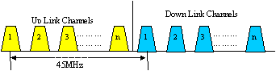
Frequency Planning
Mobile cellular communication is a full duplex system where the entire allocated bandwidth of a service provider is divided into two equal halves: one half is for uplink channels and the other half for down link channels. A guard band of 45MHz is maintained between up and down link channel of a particular call to avoid interference.

Slide 19
AMPS has two different band named Band-A and band-B, each has 12.5 MHz band of frequency (10MHz is called non-expanded spectrum and 2.5 MHz is the expanded spectrum). Channel spacing in AMPS is 30 KHz therefore total 12.5 MHz/30KHz = 416 channels are available for each band among them 21 channels are used as control channel and the remaining 395 for voice call.
Notes:
Advanced Mobile Phone System (AMPS) was an analog mobile phone system standard developed by Bell Labs, and officially introduced in the Americas on October 13, 1983, Israel in 1986, Australia in 1987, Singapore in 1988, and Pakistan in 1990. It was the primary analog mobile phone system in North America (and other locales) through the 1980s and into the 2000s.
AMPS is a first-generation cellular technology that uses separate frequencies, or "channels", for each conversation. It therefore required considerable bandwidth for a large number of users. In general terms, AMPS was very similar to the older "0G" Improved Mobile Telephone Service, but used considerably more computing power in order to select frequencies, hand off conversations to PSTN lines, and handle billing and call setup.
AMPS is a standard system for analog signal cellular telephone service in the United States and is also used in other countries. ... AMPS allocates frequency ranges within the 800 and 900 Megahertz (MHz) spectrum to cellular telephone.
‘
Each duplex channel was composed of 2 frequencies. 416 of these were in the 824–849 MHz range for transmissions from mobile stations to the base stations, paired with 416 frequencies in the 869–894 MHz range for transmissions from base stations to the mobile stations. Each cell site used a different subset of these channels than its neighbors to avoid interference. This significantly reduced the number of channels available at each site in real-world systems. Each AMPS channel had a one way bandwidth of 30 kHz, for a total of 60 kHz for each duplex channel.

Slide 20
Band A Frequency for 7/21 pattern
1A | 2A | 3A | 4A | 5A | 6A | 7A | 1B | 2B | 3B | 4B | 5B | 6B | 7B | 1C | 2C | 3C | 4C | 5C | 6C | 7C
1 | 2 | 3 | 4 | 5 | 6 | 7 | 8 | 9 | 10 | 11 | 12 | 13 | 14 | 15 | 16 | 17 | 18 | 19 | 20 | 21
22 | 23 | 24 | 25 | 26 | 27 | 28 | 29 | 30 | 31 | 32 | 33 | 34 | 35 | 36 | 37 | 38 | 39 | 40 | 41 | 42
43 | 44 | 45 | 46 | 47 | 48 | 49 | 50 | 51 | 52 | 53 | 54 | 55 | 56 | 57 | 58 | 59 | 60 | 61 | 62 | 63
64 | 65 | 66 | 67 | 68 | 69 | 70 | 71 | 72 | 73 | 74 | 75 | 76 | 77 | 78 | 79 | 80 | 81 | 82 | 83 | 84
85 | 86 | 87 | 88 | 89 | 90 | 91 | 92 | 93 | 94 | 95 | 96 | 97 | 98 | 99 | 100 | 101 | 102 | 103 | 104 | 105
106 | 107 | 108 | 109 | 110 | 111 | 112 | 113 | 114 | 115 | 116 | 117 | 118 | 119 | 120 | 121 | 122 | 123 | 124 | 125 | 126
127 | 128 | 129 | 130 | 131 | 132 | 133 | 134 | 135 | 136 | 137 | 138 | 139 | 140 | 141 | 142 | 143 | 144 | 145 | 146 | 147
148 | 149 | 150 | 151 | 152 | 153 | 154 | 155 | 156 | 157 | 158 | 159 | 160 | 161 | 162 | 163 | 164 | 165 | 166 | 167 | 168
169 | 170 | 171 | 172 | 173 | 174 | 175 | 176 | 177 | 178 | 179 | 180 | 181 | 182 | 183 | 184 | 185 | 186 | 187 | 188 | 189
190 | 191 | 192 | 193 | 194 | 195 | 196 | 197 | 198 | 199 | 200 | 201 | 202 | 203 | 204 | 205 | 206 | 207 | 208 | 209 | 210
211 | 212 | 213 | 214 | 215 | 216 | 217 | 218 | 219 | 220 | 221 | 222 | 223 | 224 | 225 | 226 | 227 | 228 | 229 | 230 | 231
232 | 233 | 234 | 235 | 236 | 237 | 238 | 239 | 240 | 241 | 242 | 243 | 244 | 245 | 246 | 247 | 248 | 249 | 250 | 251 | 252
253 | 254 | 255 | 256 | 257 | 258 | 259 | 260 | 261 | 262 | 263 | 264 | 265 | 266 | 267 | 268 | 269 | 270 | 271 | 272 | 273
274 | 275 | 276 | 277 | 278 | 279 | 280 | 281 | 282 | 283 | 284 | 285 | 286 | 287 | 288 | 289 | 290 | 291 | 292 | 293 | 294
295 | 296 | 297 | 298 | 299 | 300 | 301 | 302 | 303 | 304 | 305 | 306 | 307 | 308 | 309 | 310 | 311 | 312
313 | 314 | 315 | 316 | 317 | 318 | 319 | 320 | 321 | 322 | 323 | 324 | 325 | 326 | 327 | 328 | 329 | 330 | 331 | 332 | 333
 |  |  |  |  |  |  |  |  |  |  |  |  |  |  | 667 | 668 | 669 | 670 | 671 | 672
673 | 674 | 675 | 676 | 677 | 678 | 679 | 680 | 681 | 682 | 683 | 684 | 685 | 686 | 687 | 688 | 689 | 690 | 691 | 692 | 693
694 | 695 | 696 | 697 | 698 | 699 | 700 | 701 | 702 | 703 | 704 | 705 | 706 | 707 | 708 | 709 | 710 | 711 | 712 | 713 | 714
715 | 716
 |  |  |  |  |  |  |  |  | 991 | 992 | 993 | 994 | 995 | 996 | 997 | 998 | 999 | 1000 | 1001 | 1002
1003 | 1004 | 1005 | 1006 | 1007 | 1008 | 1009 | 1010 | 1011 | 1012 | 1013 | 1014 | 1015 | 1016 | 1017 | 1018 | 1019 | 1020 | 1021 | 1022 | 1023

Slide 21
Band B Frequency for 7/21 pattern
1A | 2A | 3A | 4A | 5A | 6A | 7A | 1B | 2B | 3B | 4B | 5B | 6B | 7B | 1C | 2C | 3C | 4C | 5C | 6C | 7C
334 | 335 | 336 | 337 | 338 | 339 | 340 | 341 | 342 | 343 | 344 | 345 | 346 | 347 | 348 | 349 | 350 | 351 | 352 | 353 | 354
355 | 356 | 357 | 358 | 359 | 360 | 361 | 362 | 363 | 364 | 365 | 366 | 367 | 368 | 369 | 370 | 371 | 372 | 373 | 374 | 375
376 | 377 | 378 | 379 | 380 | 381 | 382 | 383 | 384 | 385 | 386 | 387 | 388 | 389 | 390 | 391 | 392 | 393 | 394 | 395 | 396
397 | 398 | 399 | 400 | 401 | 402 | 403 | 404 | 405 | 406 | 407 | 408 | 409 | 410 | 411 | 412 | 413 | 414 | 415 | 416 | 417
418 | 419 | 420 | 421 | 422 | 423 | 424 | 425 | 426 | 427 | 428 | 429 | 430 | 431 | 432 | 433 | 434 | 435 | 436 | 437 | 438
439 | 440 | 441 | 442 | 443 | 444 | 445 | 446 | 447 | 448 | 449 | 450 | 451 | 452 | 453 | 454 | 455 | 456 | 457 | 458 | 459
460 | 461 | 462 | 463 | 464 | 465 | 466 | 467 | 468 | 469 | 470 | 471 | 472 | 473 | 474 | 475 | 476 | 477 | 478 | 479 | 480
481 | 482 | 483 | 484 | 485 | 486 | 487 | 488 | 489 | 490 | 491 | 492 | 493 | 494 | 495 | 496 | 497 | 498 | 499 | 500 | 501
502 | 503 | 504 | 505 | 506 | 507 | 508 | 509 | 510 | 511 | 512 | 513 | 514 | 515 | 516 | 517 | 518 | 519 | 520 | 521 | 522
523 | 524 | 525 | 526 | 527 | 528 | 529 | 530 | 531 | 532 | 533 | 534 | 535 | 536 | 537 | 538 | 539 | 540 | 541 | 542 | 543
544 | 545 | 546 | 547 | 548 | 549 | 550 | 551 | 552 | 553 | 554 | 555 | 556 | 557 | 558 | 559 | 560 | 561 | 562 | 563 | 564
565 | 566 | 567 | 568 | 569 | 570 | 571 | 572 | 573 | 574 | 575 | 576 | 577 | 578 | 579 | 580 | 581 | 582 | 583 | 584 | 585
586 | 587 | 588 | 589 | 590 | 591 | 592 | 593 | 594 | 595 | 596 | 597 | 598 | 599 | 600 | 601 | 602 | 603 | 604 | 605 | 606
607 | 608 | 609 | 610 | 611 | 612 | 613 | 614 | 615 | 616 | 617 | 618 | 619 | 620 | 621 | 622 | 623 | 624 | 625 | 626 | 627
628 | 629 | 630 | 631 | 632 | 633 | 634 | 635 | 636 | 637 | 638 | 639 | 640 | 641 | 642 | 643 | 644 | 645 | 646 | 647 | 648
649 | 650 | 651 | 652 | 653 | 654 | 655 | 656 | 657 | 658 | 659 | 660 | 661 | 662 | 663 | 664 | 665 | 666
 |  |  |  |  | 717 | 718 | 719 | 720 | 721 | 722 | 723 | 724 | 725 | 726 | 727 | 728 | 729 | 730 | 731 | 732
733 | 734 | 735 | 736 | 737 | 738 | 739 | 740 | 741 | 742 | 743 | 744 | 745 | 746 | 747 | 748 | 749 | 750 | 751 | 752 | 753
754 | 755 | 756 | 757 | 758 | 759 | 760 | 761 | 762 | 763 | 764 | 765 | 766 | 767 | 768 | 769 | 770 | 771 | 772 | 773 | 774
775 | 776 | 777 | 778 | 779 | 780 | 781 | 782 | 783 | 784 | 785 | 786 | 787 | 788 | 789 | 790 | 791 | 792 | 793 | 794 | 795
796 | 797 | 798 | 799

Slide 22
N=7 cell pattern
In N=7 cell cluster of omni three frequency groups of table 2 or 3 is used per cell following the sequence (N, N+7,N+14) where N is the cell number. The channel isolation within a cell is 7×30KHz=210KHz. The channel isolation of adjacent cell is 30KHz between cell 1 and 2 and that of 1 and 3 is 60KHz etc.The separation between adjacent cell,
1.5R
4.33R
3
3,10,17
6
6,13,20
5
5,12,19
3
3,10,17
1
1,8,15
6
6,13,20
5
5,12,19
4
4,11,18
7
7,14,21
1
1,8,15
2
2,9,16
4
4,11,18
7
7,14,21
3
3,10,17
2
2,9,16
dB
6
6,13,20
5
5,12,19
1
1,8,15
4
4,11,18
7
7,14,21
; taking number of co-channel interference j=6, propagation constant γ=4
2
2,9,16
Notes:
Root of 3+Root of 3+Root of 3%2

Slide 23
Sometimes cell cluster is formed arranging the cells in two rows like fig.2 having alternate channel assignments known as trapezoidal plan. Here the minimum separation between adjacent channel cells is 2×30=60KHz; better than the previous one.
dB
1
1,8,15
5
5,12,19
2
2,9,16
6
6,13,20
≈8R
1.5R
3
3,10,17
7
7,14,21
4
4,11,18
1
1,8,15
5
5,12,19
2
2,9,16
6
6,13,20
1
1,8,15
5
5,12,19
2
2,9,16
6
6,13,20
3
3,10,17
7
7,14,21
4
4,11,18
3
3,10,17
7
7,14,21
4
4,11,18
1
1,8,15
5
5,12,19
2
2,9,16
6
6,13,20
3
3,10,17
7
7,14,21
4
4,11,18
≈8.1R
Notes:
Root of 3+Root of 3+Root of 3+Root of 3%2

Slide 24
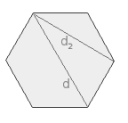
d = 2 * a d₂ = √3 * a
Where a is radius

